Slide 1
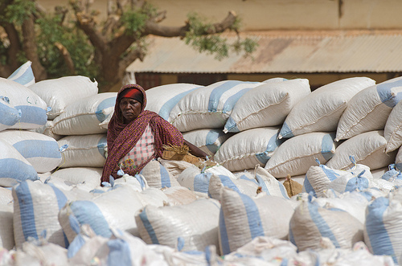
Scal
Scaling Up: An Approach and
Lessons from Experience
Conference on Innovation for Inclusive Growth February 10-12, 2015
New Delhi, India Johannes F. Linn

Slide 2
What we’ll talk about
Some background
A framework of analysis
An example
Lessons
References

Slide 3
Scaling up – Some background

Slide 4
Scaling up – what is it?
It’s not about more money (although that may help)
It’s about more impact by improving more people’s lives on a lasting basis
It’s not about individual projects (although they are important instruments for planning and implementation)
It’s about supporting longer-term programs of engagement and building momentum that lasts beyond the program
It’s not only about what governments or donors do
It’s about getting programs right on the ground, whether with government or external assistance or without, but governments and donors should support, rather than hinder, scaling up

Slide 5
Types of scaling up
Expansion of services to more people in a given geographical area (fill-in)
Horizontal replication, from one geographic area to another (including across borders → South-South cooperation)
Vertical scaling-up (policy, legal, institutional reform for mainstreaming an approach)
Functional expansion, by adding additional functional areas of engagement

Slide 6
Why worry about scaling up?
Ambitious national and global development goals (MDGs,SDGs, etc.)
But problems with design and implementation of development programs:
Too many one-off efforts, “pilots to nowhere”
Too little learning from and building on successes and mistakes
Too few partnerships
Failure to “connect the dots”, i.e., to reap the benefits of scale through learning, replication with adaptation, and partnership
Too many national and sector plans work top-down; we also need to work from program level up by thinking about how to scale up what works (“beyond project”)
External assistance tends to reinforce these problems with its fragmentation, project approach, short-term results focus

Slide 7
A topic of growing interest
Jim Wolfensohn/World Bank/China: Shanghai 2004 conference and publications
Various academic and think tank initiatives, including Wolfensohn Center for Development at Brookings: research/advice since 2005
Many examples of successful scaling up (River Blindness Program, Grameen Bank and BRAC, Mexico’s Progresa CCT program, India’s urban and rural dev. programs, China’s approach, etc.), but no systematic consideration of scaling up
Now growing interest world-wide: we have worked with IFAD, UNDP, JICA, KOICA, AusAID, World Bank, GIZ, IFPRI, USAID, Heifer International; OECD-DAC scaling up prize
Post-2015 Agenda

Slide 8
Scaling up – A simple framework of analysis
Notes:
Helps to get a common language; systematically assess the scaling up processes – pathways – and the factors influencing them

Slide 9
Innovation, learning and scaling up as an iterative process
Internal
knowledge
New idea, model, approach
Pilot,
Project
M&E,
Learning
& KM
Scale up
Outside
knowledge
Multiple
Impact
Limited
Impact
Notes:
9

Slide 10
Scaling up pathway: Which drivers and spaces?
Drivers (champions, incentives, market or community demand, etc.)
Vision of
Scaled Up Program
Spaces (enabling factors)
Fiscal and Financial
Institutional
Policies
Politcal
Environment
Partnership
Etc
Innovation
Monitor and Evaluate

Slide 11
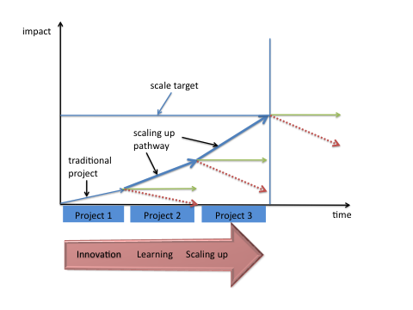
A multi-year, multi-project programmatic approach to scaling up

Slide 12
An Example

Slide 13
Highland area development in Peru
8 IFAD loans since 1980 for rural poverty reduction through successive area-based projects
>150,000 rural households, 30% of highland communities
Multi-dimensional scaling up
Geographic

Slide 14
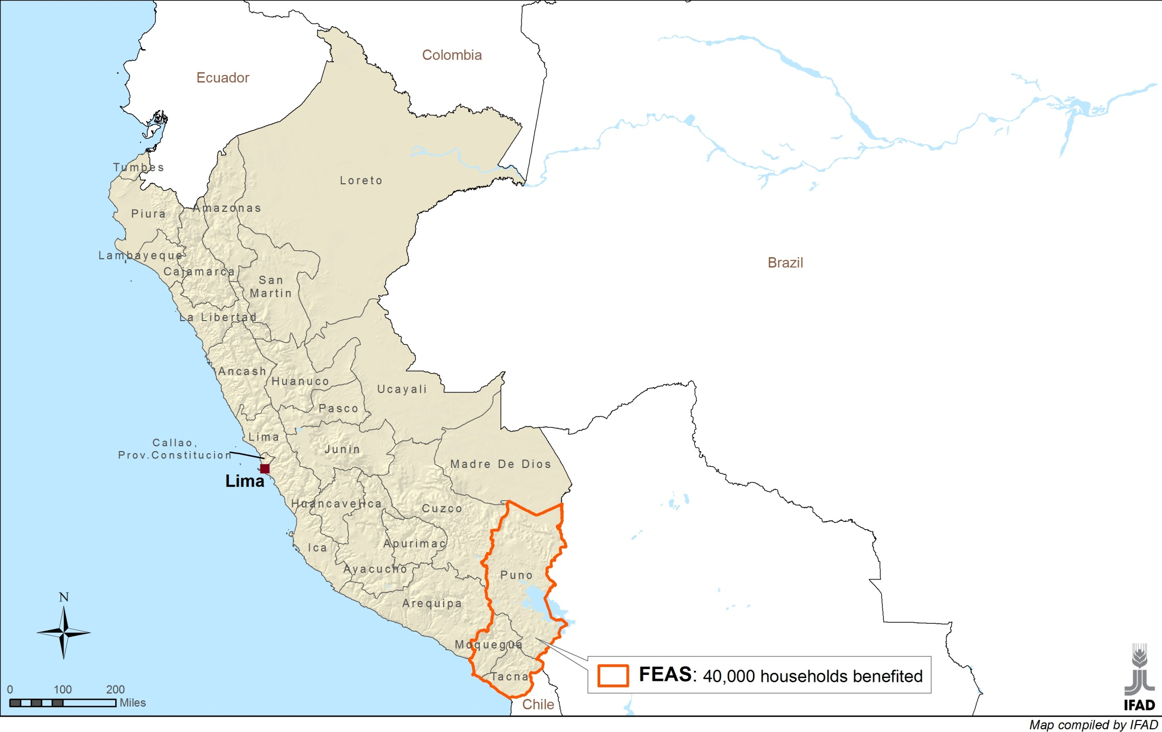
Peru: Geographical expansion
Notes:
All five essential innovations described earlier are in the process of being institutionally scaled up. Their mainstreaming is characterized by different degrees of maturity in their respective spaces and drivers. Key to this success was that the exit strategy was transformed into a learning pathway with sequential projects building up on proven innovations. After 20 years scaling up was born. 10 years later, scaling up has been mainstreamed into national policies and agencies
The interactive map shows the geographical pathway of scaling up, from the southern highland to the northern highlands and the respective results/impact

Slide 15
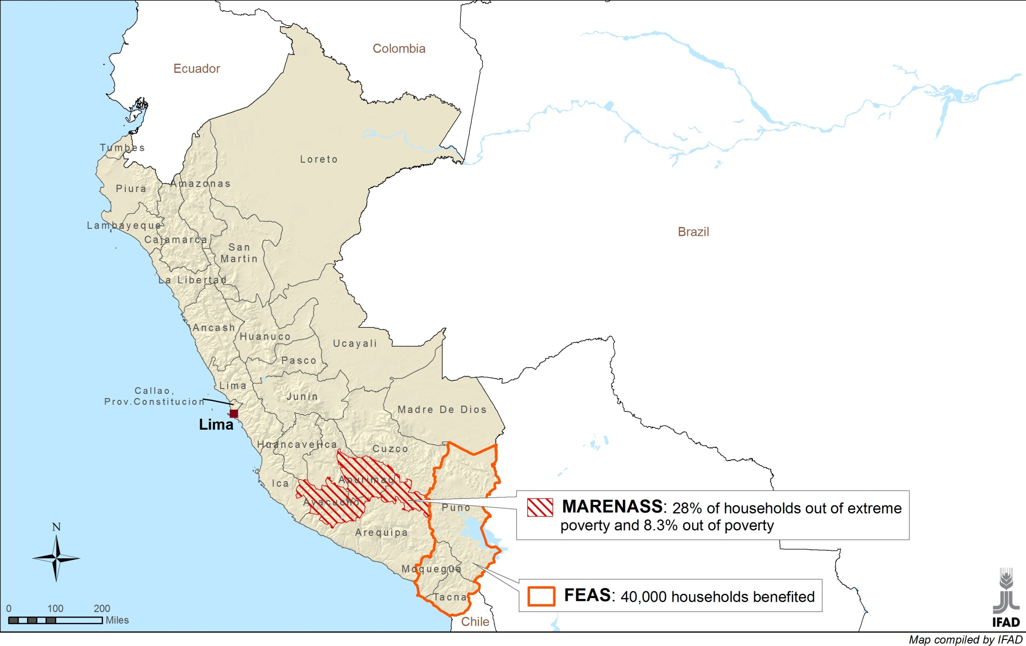
Peru: Geographical expansion
Notes:
All five essential innovations described earlier are in the process of being institutionally scaled up. Their mainstreaming is characterized by different degrees of maturity in their respective spaces and drivers. Key to this success was that the exit strategy was transformed into a learning pathway with sequential projects building up on proven innovations. After 20 years scaling up was born. 10 years later, scaling up has been mainstreamed into national policies and agencies
The interactive map shows the geographical pathway of scaling up, from the southern highland to the northern highlands and the respective results/impact

Slide 16
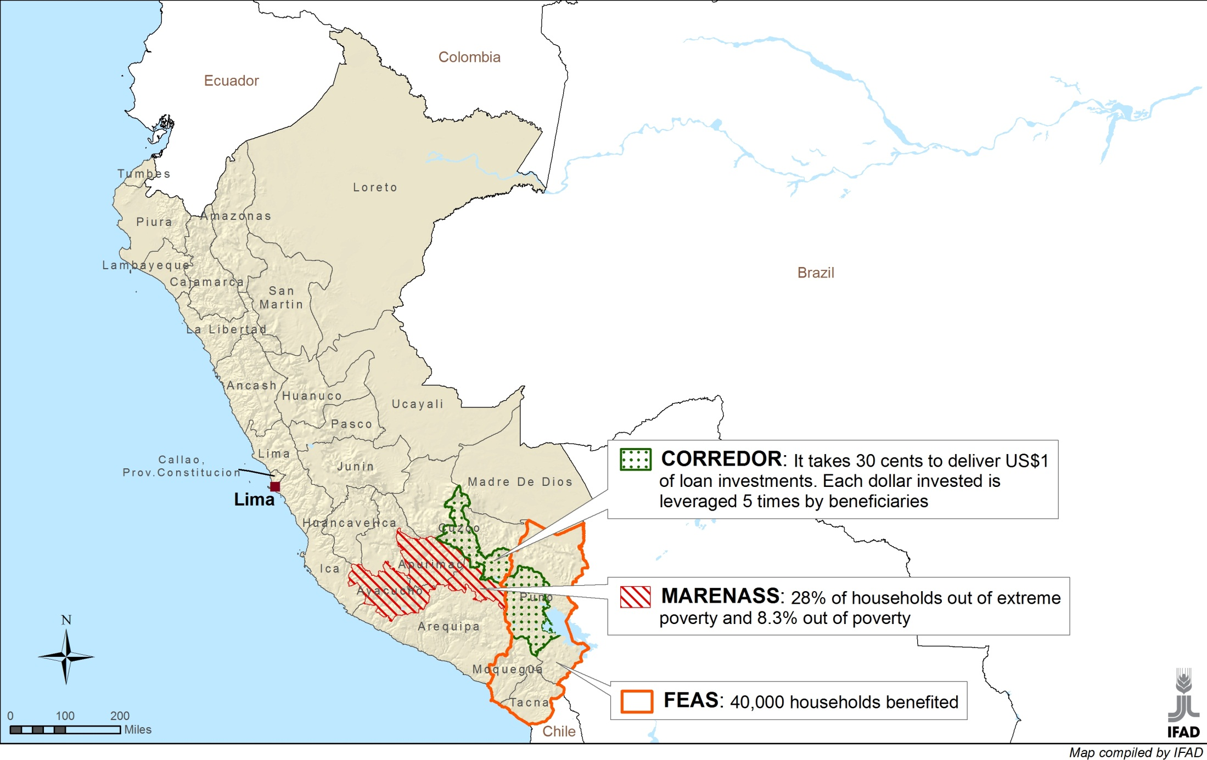
Peru: Geographical expansion
Notes:
All five essential innovations described earlier are in the process of being institutionally scaled up. Their mainstreaming is characterized by different degrees of maturity in their respective spaces and drivers. Key to this success was that the exit strategy was transformed into a learning pathway with sequential projects building up on proven innovations. After 20 years scaling up was born. 10 years later, scaling up has been mainstreamed into national policies and agencies
The interactive map shows the geographical pathway of scaling up, from the southern highland to the northern highlands and the respective results/impact

Slide 17
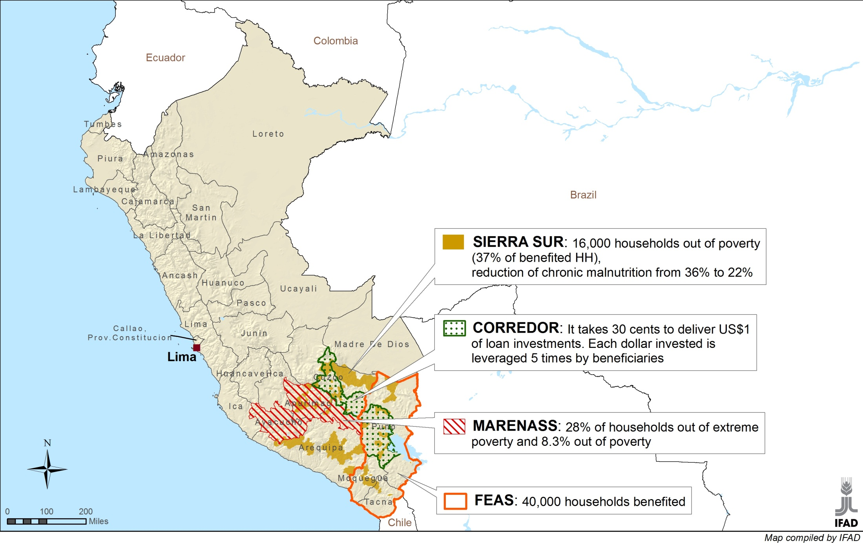
Peru: Geographical expansion
Notes:
All five essential innovations described earlier are in the process of being institutionally scaled up. Their mainstreaming is characterized by different degrees of maturity in their respective spaces and drivers. Key to this success was that the exit strategy was transformed into a learning pathway with sequential projects building up on proven innovations. After 20 years scaling up was born. 10 years later, scaling up has been mainstreamed into national policies and agencies
The interactive map shows the geographical pathway of scaling up, from the southern highland to the northern highlands and the respective results/impact

Slide 18
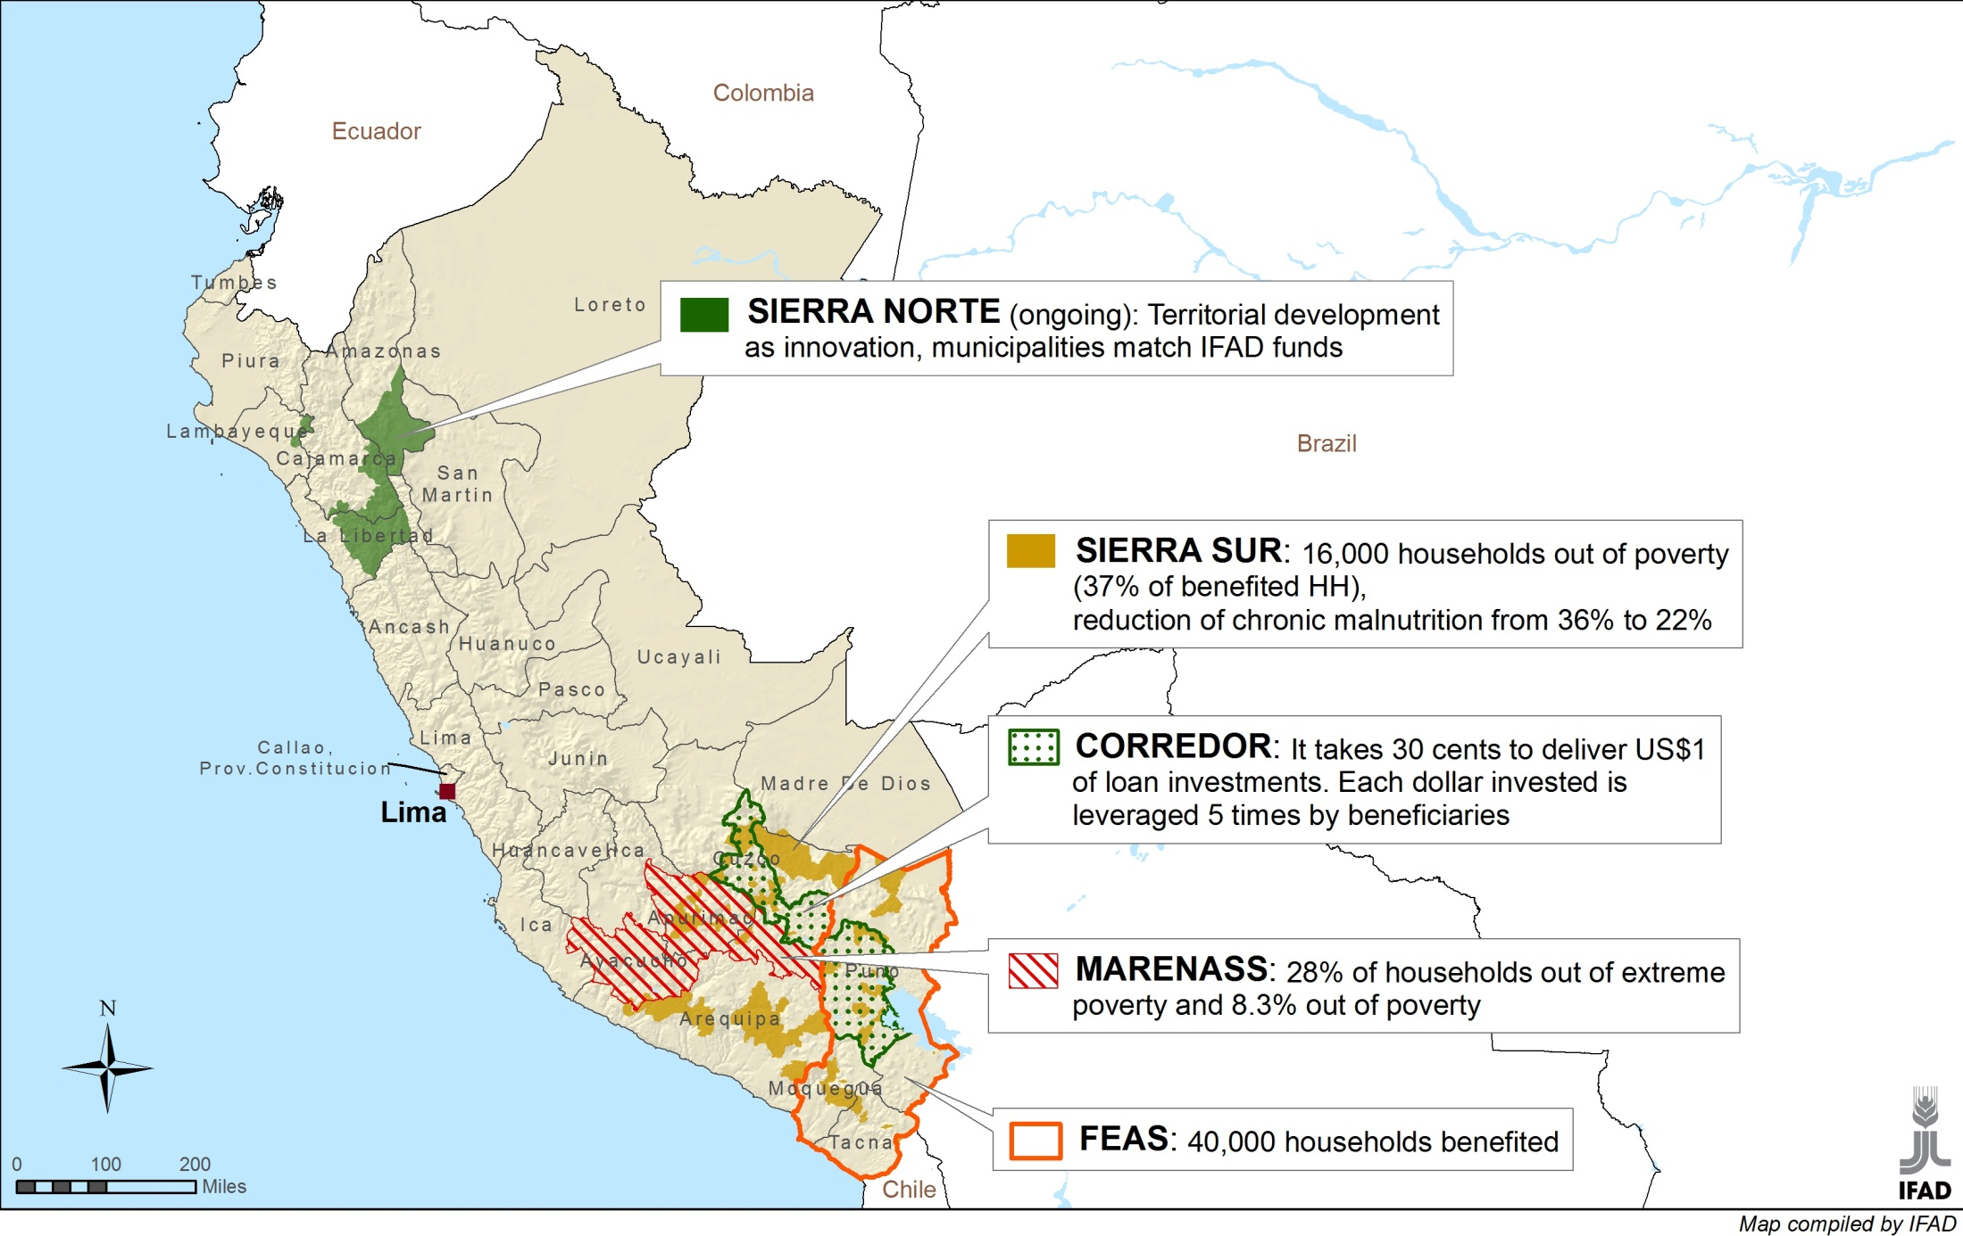
Peru: Geographical expansion
Notes:
All five essential innovations described earlier are in the process of being institutionally scaled up. Their mainstreaming is characterized by different degrees of maturity in their respective spaces and drivers. Key to this success was that the exit strategy was transformed into a learning pathway with sequential projects building up on proven innovations. After 20 years scaling up was born. 10 years later, scaling up has been mainstreamed into national policies and agencies
The interactive map shows the geographical pathway of scaling up, from the southern highland to the northern highlands and the respective results/impact

Slide 19
An example: Highland area development in Peru
8 IFAD loans since 1980 for rural poverty reduction through successive area-based projects
>150,000 rural households, 30% of highland communities
Multi-dimensional scaling up
Geographic, functional, vertical
Drivers
Innovative interventions

Slide 20
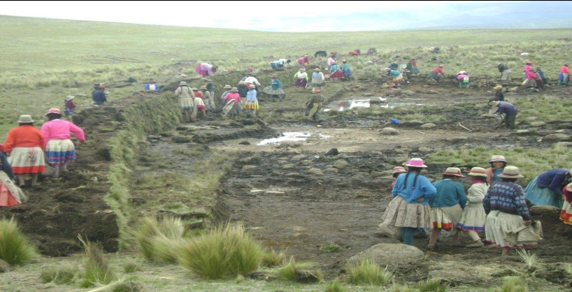
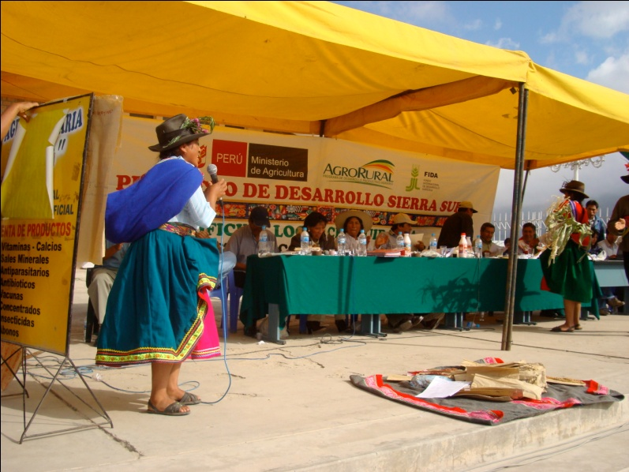
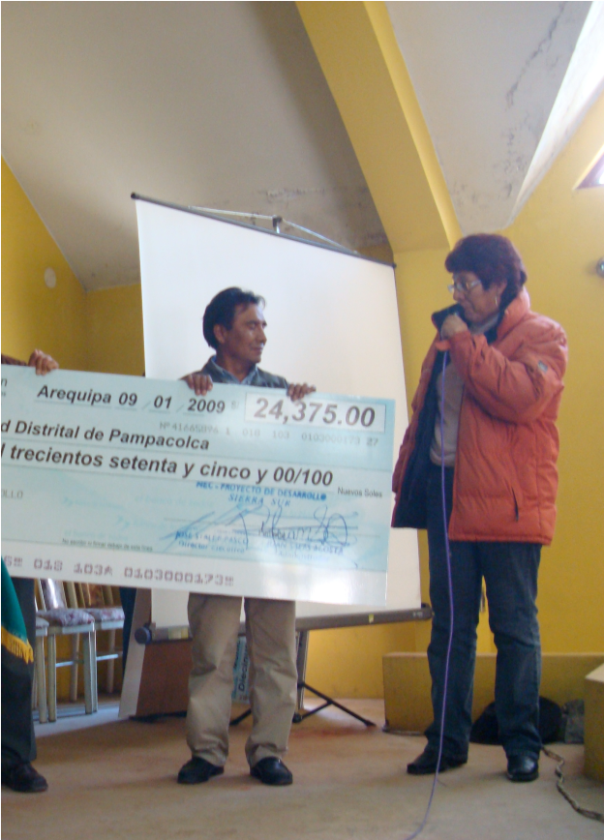
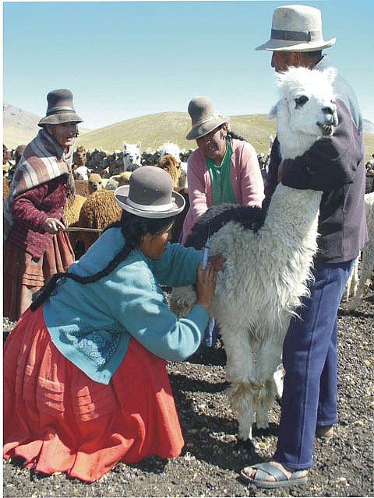
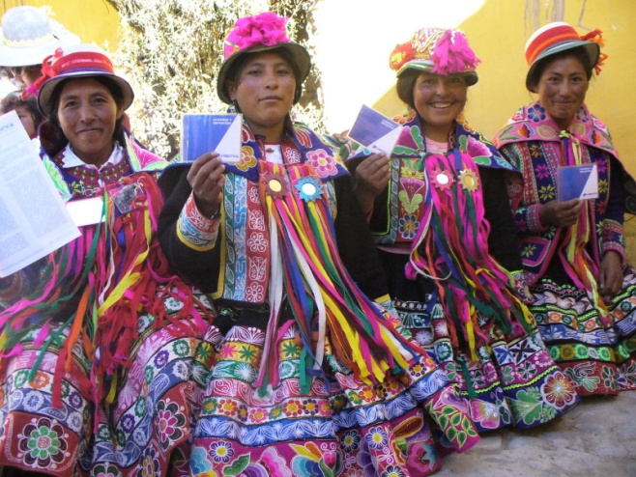
Peru - Key community-based innovations being scaled up
Local Resource Allocation Commitees (LARC)
‘Concursos’ (competitions) around NRM
Local talents
Direct transfer of public funds
Women saving accounts
Notes:
Five key innovations were scaled up within the IFAD projects. They do not represent silver bullets nor blue-prints. These approaches and tools are all interrelated and used in different proportions and degrees of maturity:
Competitions (‘concursos’), Transferring funds,Local Resource allocation (LARCs or CLARs in Spanish),Local Talents
Women saving accounts.
‘Concursos’:One of the driving factors to achieve mass dissemination and application of farmer led best practices is the “Pacha Mama Raymi” methodology which was introduced by IFAD as an innovation in the MARENASS project. 73% of MARENASS HH has joined a ‘concursos.
The direct transfer of resources to community organizations is a key instrument for empowerment. Local organizations are fully responsible in all projects for the use of project funds to contract technical assistance providers, organize in situ training and implement a myriad of project-related activities. The transfer of funds to recognized local organizations who manage these funds without outside interference has been a radical change from the conventional public investment paradigm. In CORREDOR 57% of the investments, representing 44% of the total budget, was transferred directly to beneficiaries to finance their business plans or for community development
Since 2004, the Government of Peru applies an administrative and financial decentralization which facilitated the creation of the Local Resource Allocation Committee (LRAC). LRACs are responsible for identifying the proposals that are to receive the available resources. Project proposals are selected by LRACs composed of regional and local governments as well as local actors. It warrants transparency in the selection of priority investments.
Local talents:With the direct funding poor ‘campesinos’ contracted private ‘técnicos or so called Yachacchiqs’ of their choice to deliver technical assistance . In MARENASS over 3000 Yachacchiqs (of which 6% women) were trained. Over 12% of these still render private services and about 11% have been absorbed by municipalities. The bulk, 58%, is engaged for their own account in NRM.
Women saving accounts:Savings accounts opened by rural women, who never had access to such rural financial services, are viewed by all stakeholders as a most effective tool for empowerment of women Savings mobilization is one of the most promising thematic innovations in the Andean region. It has been scaled up not only in IFAD projects ( aprox. 20 000 accounts) but being mainstreamed in the Conditional Cash Tranfer Porgramme JUNTOS with the support of AGRORURAL.

Slide 21
An Example: Highland area development in Peru
8 IFAD loans since 1980 for rural poverty reduction through successive area-based projects
>150,000 rural households, 30% of highland communities
Multi-dimensional scaling up
Geographic, functional, vertical
Drivers
Innovative interventions, community demand, expert network, IFAD staff, eventually the government (and history of crisis)
Spaces
Political, policy, institutional, fiscal, cultural, learning
IFAD’s role: support and finance
Flexible, innovative, stick-with-it, building on experience
Long-term project manager close to the action and committed to scaling up

Slide 22
Lessons from experience with scaling up

Slide 23
Lessons
Actors: multiplicity at multiple levels; requires multi-stakeholder alliances
Dimensions: horizontal and vertical scaling up usually go hand in hand
Pathways: no unique process, but
Successful scaling up takes time, even decades; requires long-term engagement with a vision of scale
Systematic planning, management, learning, ready to take opportunities
It helps to consider drivers and constraints or enabling factors (spaces)
Not all innovations/interventions can or should be scaled up.

Slide 24
Lessons (ctd)
Community engagement, ownership and demand: key drivers for programs at the base of the pyramid
Assist in building institutions OF, not FOR, the poor
Scaling up and sustainability: inter-dependent and related to same drivers/spaces
Risks: scaling up entails risks, but probably less than fragmented, one-off projects; risks need to explicitly managed

Slide 25
Lessons for donors
Support (don’t hinder) scaling up
Move from a one-off project to a programmatic/scaling-up approach
Plan for the long-term, watch continuity, stick with it; but prepare for eventual hand-off
Develop potential pathways early on and take proactive steps to plan and prepare for scaling up (go beyond “exit strategies”)
Involve communities
Explore especially the institutional, policy, fiscal, learning and partnership spaces that allow scaling up
Keep it simple

Slide 26
Selected References
L. Chandy, A. Hosono, H. Kharas & J. Linn, eds. 2013. Getting to scale. Brookings, Washington, DC
A. Hartmann and J. Linn. 2008. “Scaling Up: A Framework and Lessons for Development Effectiveness from Literature and Practice.” Wolfensohn Center Working Paper No. 5. Brookings. Washington, DC
J. Linn, A. Hartmann, H. Kharas, R. Kohl, and B. Massler. 2010. “Scaling Up the Fight Against Rural Poverty: An Institutional Review of IFAD’s Approach”, Global Working Paper No. 39 , Brookings. Washington, DC
L. Cooley and J. Linn. 2014. “Taking Innovations to Scale: Methods, Applications and Lessons.” Results for Development and MSI. Washington, DC
J. Linn, ed. 2012 Scaling Up in Agriculture, Rural Development and Nutrition. 2020 Focus Briefs, No. 19. International Food Policy and Research Institute. Washington, DC
L. Cooley and R. Ved, 2012. “Scaling Up—From Vision to Large Scale Change: A Management Framework for Practitioners, Second Edition.” MSI. Washington, DC
A. Hartmann, H. Kharas, R. Kohl, J. Linn, B. Massler and C. Sourang. 2013. “Scaling Up Programs for the Rural Poor: IFAD’s Experience, Lessons and Prospects (Phase 2).” Global Economy& Development Working Paper 54. Brookings

Slide 27
Thank you!

Slide 28
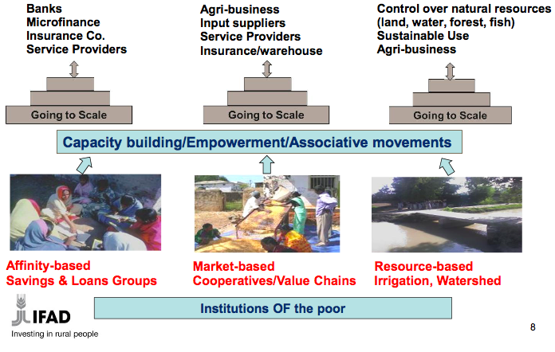
Annex: Scale up institutions OF the poor

Slide 29
Annex: The MSI 3-step approach to managing scaling up
Step 1: Develop a scaling-up plan
▪ Task 1: Create a vision ▪ Task 2: Assess scalability ▪ Task 3: Fill information gaps ▪ Task 4: Prepare a scaling-up plan
Step 2: Establish the preconditions for scaling up
▪ Task 5: Legitimize change ▪ Task 6: Build a constituency ▪ Task 7: Realign and mobilize the needed resources
Step 3: Implement the scaling up process
▪ Task 8: Modify organizational structures ▪ Task 9: Coordinate action ▪ Task 10: Track performance and maintain momentum
Source: Cooley and Ved

